Slide 1
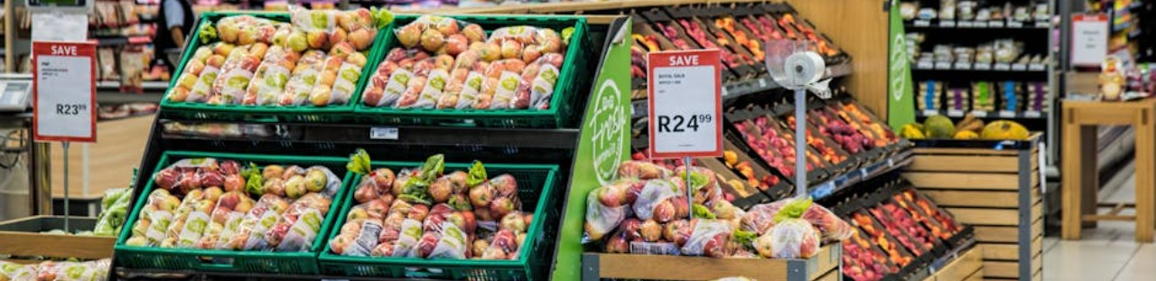
DMart Sales Analysis
Presentation by Sanjay Peguda
January - 2025

Slide 2
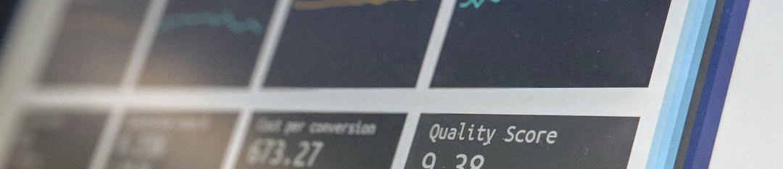
Sales Overview
KEY SALES METRICS
The sales overview provides an essential snapshot of DMart's performance. Key metrics include total sales of $14.96M, total profit of $3.75M, and a total of 9,994 orders processed.

Slide 3
REGIONAL PERFORMANCE
32%
16%
26%
26%
HIGH SALES
UNDERPERFORMANCE
MODERATE PERFORMANCE
MODERATE PERFORMANCE
The West region contributes 32% to total sales, indicating its strategic importance.
The South region underperforms with only 16.32% contribution.
The North region shows a moderate performance at 26%.
Similar to the North, the East also accounts for 26% of total sales.

Slide 4
CATEGORY INSIGHTS
This table summarizes the performance of top and underperforming categories. 'Eggs, Meat & Fish' and 'Fruits & Veggies' excel, while 'Oil & Masala' and 'Bakery' lag behind, indicating areas for improvement.
Category | Sales ($M) | Performance
Eggs, Meat & Fish | 5.00 | Top Performer
Fruits & Veggies | 4.50 | Top Performer
Oil & Masala | 2.00 | Underperformer
Bakery | 1.50 | Underperformer
Others | 2.96 | Moderate Perf.

Slide 5

Sales Trends
DAILY SALES TRENDS
Sales peak on Tuesdays with $2.7M, while Thursdays see the lowest sales at $1.3M. This pattern shows that specific days yield higher sales, influencing promotional strategies.
MONTHLY SALES OVERVIEW
December shows strong sales, hitting $1.6M, while April and May underperform at $1.0M each. Seasonal campaigns are necessary to boost performance during these months.

Slide 6
Improvement Strategies
REGIONAL FOCUS
CATEGORY ADJUSTMENTS
TIMING PROMOTIONS
Target promotions in the South region to enhance sales. Understanding local preferences is crucial for these initiatives.
Optimize inventory and pricing for 'Oil & Masala' and 'Bakery' to revive sales. Bundling underperformers with top sellers may drive better results.
Introduce special offers during off-peak times like Thursdays. Seasonal campaigns can capitalize on shopping patterns observed in peak months.

Slide 7
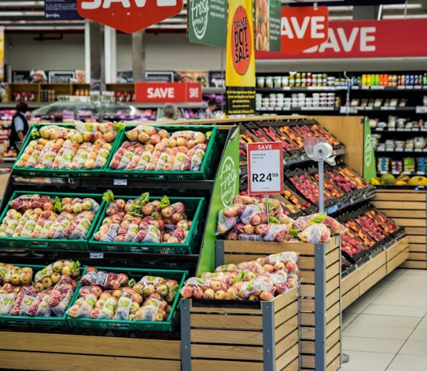
Conclusion & Impact
SUMMARY OF RECOMMENDATIONS
To boost DMart's sales and profitability, focus on enhancing the South region's performance, addressing category weaknesses, and leveraging peak sales days. Implementing these strategies could yield a substantial 15-20% increase in sales.

